Slide 1





Dept. of CS&E ( DATA SCIENCE) Adichunchanagiri Institute of Technology Chikkamagaluru - 577102
Mini Project – Seminar
On
‘‘ MediScan AI : Instant Patient History Retrieval & Emergency Aid ’’
Presented By,
Group No : 04
Tarun G (4AI23CD056)
Sai Gokul P V (4AI23CD045)
Likeeth G Urs (4AI23CD025)
Nikhil L U (4AI23CD031)
Under the Guidance Of
Asst Prof . Harshitha H D

Slide 2


AGENDA
  Problem Statement
  Scope of the Project
  Project Design
  Methodology
  Implementation
  Challenges Faced
  Results
  Conclusion
  Future Work
  GitHub Link
  Question

Slide 3
PROBLEM STATEMENT
This platform provides doctors with instant access to patient medical history using phone number, name and place. AI modules summarize history and highlight emergency risks, ensuring faster, safer treatment and preventing loss of life due to inaccessible records.

Slide 4

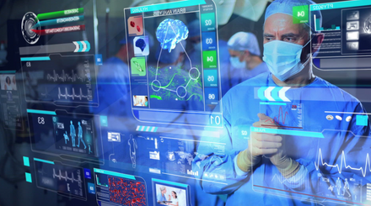
SCOPE OF THE PROJECT
MediScan AI focuses on providing instant access to patient medical history using AI summarizer. It aims to support doctors during emergencies by delivering quick, accurate, and reliable health information. The system enhances emergency decision-making through data retrieval and risk indicator.
Key Features
  Instant retrieval of patient medical history.
  AI summarizer of medical records.
  Emergency risk indicator.
  Useful for hospitals, emergency wards, and doctors.
  Allow multi-mode search: health ID , phone number and name.

Slide 5

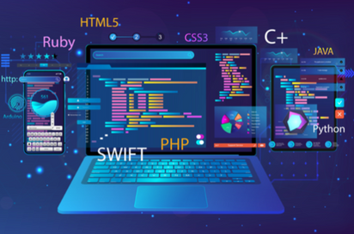
PROJECT DESIGN
System components :
Frontend:
  Framework: React (v18) built with Vite, Capacitor (Mobile)
  Language: TypeScript.
  Styling: Tailwind CSS.
Backend:
  Runtime: Node.js.
  Framework: Express.js.
  Language: TypeScript, Python.
  API Architecture: RESTful API structure.

Slide 6

Database: MongoDB
  Stores patient data, reports and summaries.
AI Components:
  MedCAT → Medical history summarization.
  Tesseract OCR → Extract medical text from reports.
Hardware Requirements:
  Camera-enabled devices.
  Smartphones, Tablets.
  Hospital systems.
Additional Tools
  Git/GitHub for version control.

Slide 7

METHODOLOGY
  Role-based login for Doctors, Patients, and Hospitals.
  Patient records fetched via ID/phone number/name.
  Hospitals update and maintain medical records securely.
  Doctors trigger AI summarization for clinical briefs.
  Patients view reports and summarized data from their dashboard.
  Authorized users can download complete or summarized reports.

Slide 8
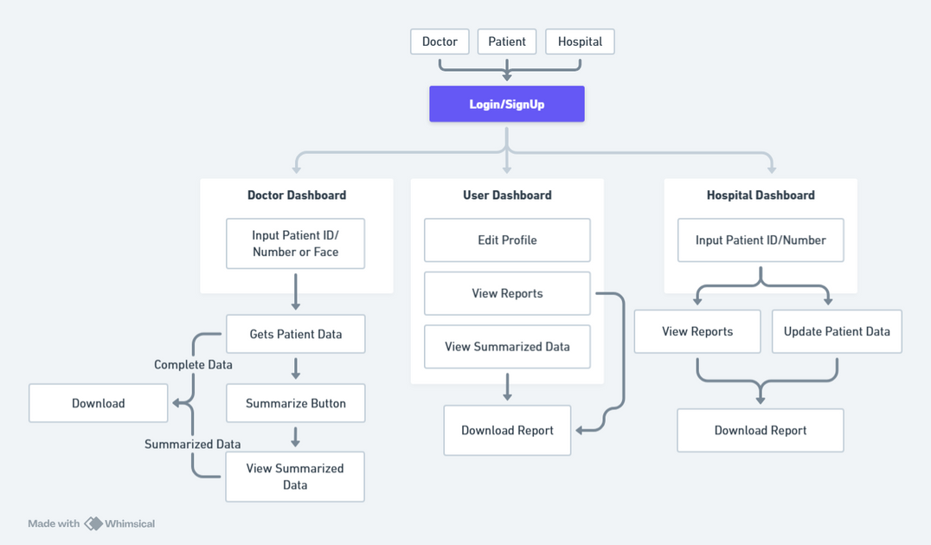

Slide 9
IMPLEMENTATION
  Web interface for doctors, patients and hospital authorities.
  Frontend communicates with backend securely via API.
  AI modules integrated for summarization.
  Patient details stored in MongoDB.
  Mobile app for quick access.

Slide 10
CHALLENGES FACED
Ensuring real-time access across web and mobile platforms.
Integrating multiple AI modules while ensuring fast, accurate medical summaries.
Ensuring end-to-end security for sensitive patient data across frontend and backend.
Converting the web platform into a functional mobile app without rebuilding the entire codebase.

Slide 11
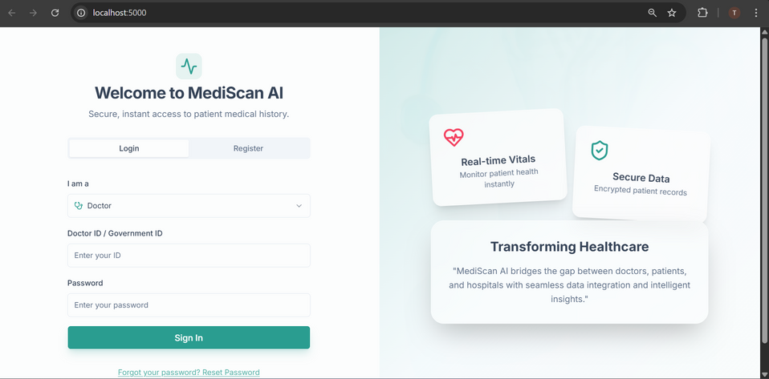
RESULTS
Role-based login/register for Doctors, Patients, and Hospitals.

Slide 12
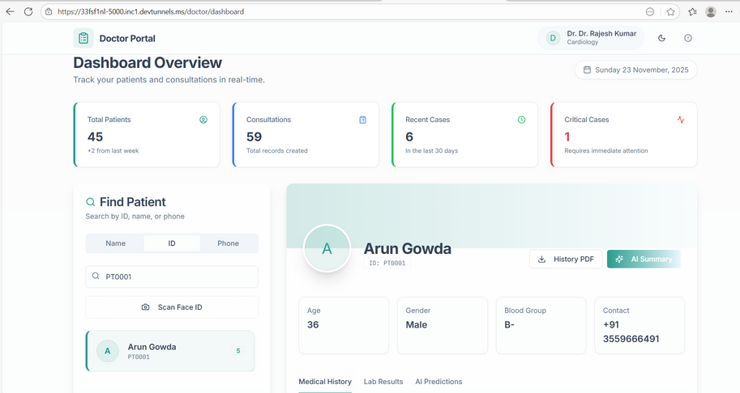
RESULTS
Doctor can view the patient health history.

Slide 13
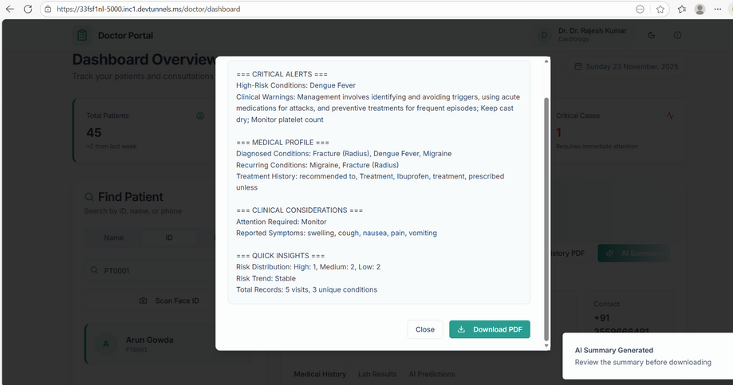
RESULTS
Doctors can summarize the whole health record and download it.

Slide 14
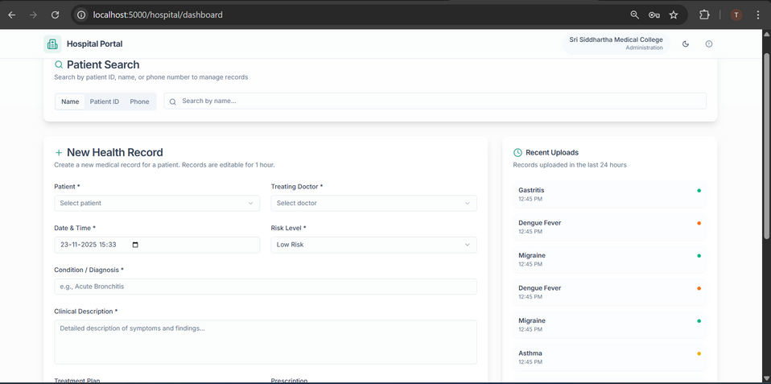
RESULTS
Hospital authority can view/upload the patient health history.

Slide 15
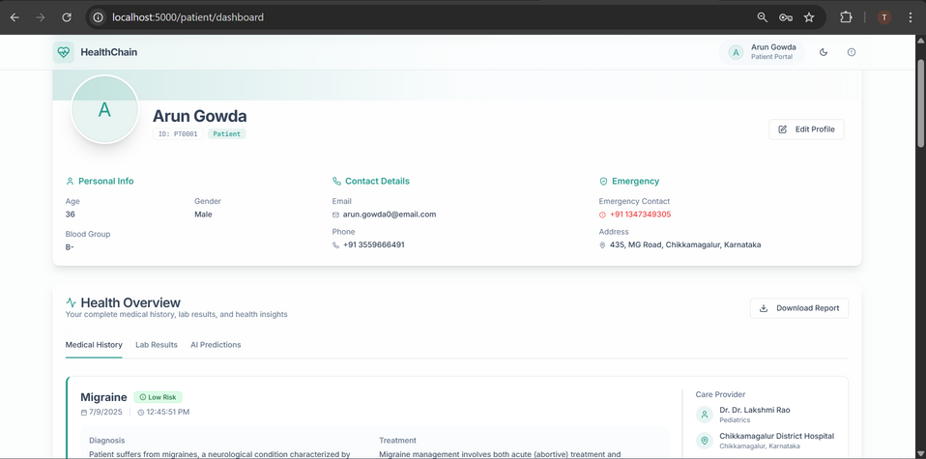
RESULTS
Patient can view, download the health records and update personal information.

Slide 16
CONCLUSION
  MediScan AI streamlines emergency care by providing doctors with immediate access to reliable patient information. Its AI-powered features reduce risks, save time, and improve overall treatment accuracy. The system proves how technology can transform patient safety and hospital workflow.

Slide 17
FUTURE WORK
  Image based patient search(Face recognition).
  Live integration with government health ID, Ayushman Bharath Health Account(ABHA).
  Real-time health monitoring device connection, Internet of Things(IoT).
  Multi-language summarization.
  Prescription generator using AI and chatbot.

Slide 18
GITHUB LINK
  GitHub Repo Name : Mediscan AI
  Link : https://github.com/Tarung33/MediscanAI.git

Slide 19
THANK YOU
QUESTIONS ?

